Slide 1
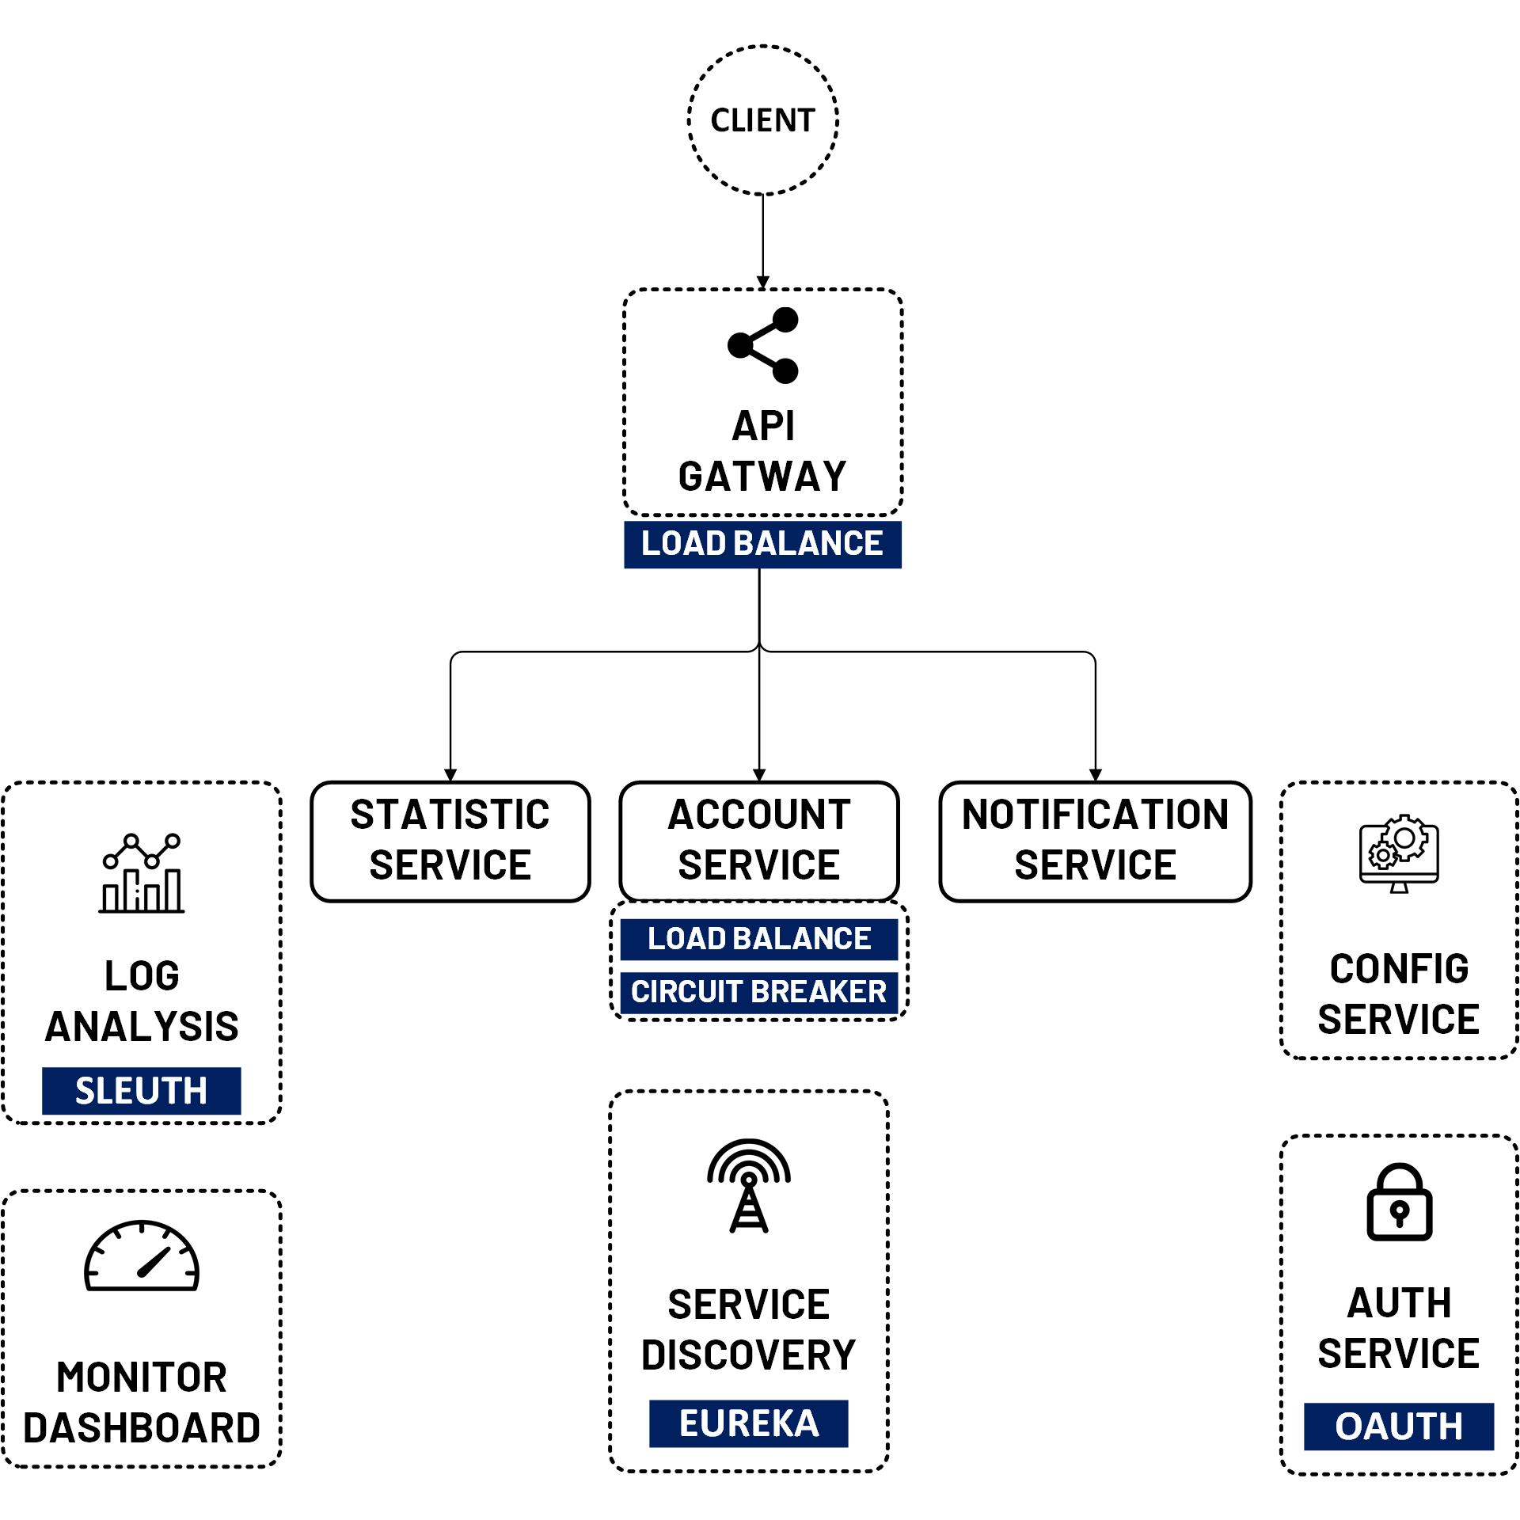

Spring Cloud Sleuth + Zipkin Trace UI
www.jmaster.io/course/microservices-with-spring-cloud

Slide 2
Zipkin
a distributed tracing system (Server & Client)
Server provide UI to find by trace id, service, etc.
Client send Trace/Span data to Zipkin Server
Server store data in-memory, or database such as Cassandra or ElasticSearch.

Slide 3
